Slide 1
6.5 day 1 Partial Fractions

Slide 2
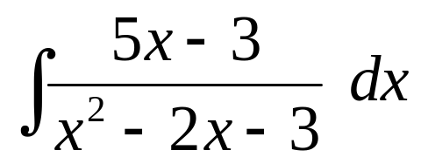
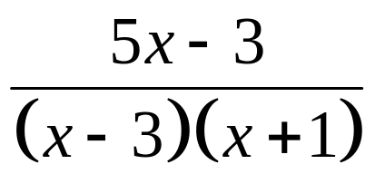
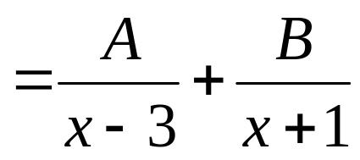

1
This would be a lot easier if we could
re-write it as two separate terms.
These are called non-repeating linear factors.
You may already know a short-cut for this type of problem. We will get to that in a few minutes.

Slide 3
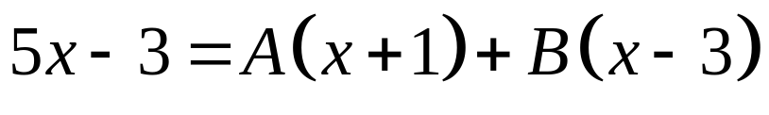





1
This would be a lot easier if we could
re-write it as two separate terms.
Multiply by the common denominator.
Set like-terms equal to each other.
Solve two equations with two unknowns.

Slide 4





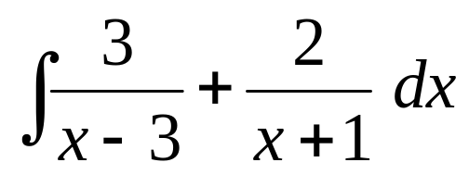
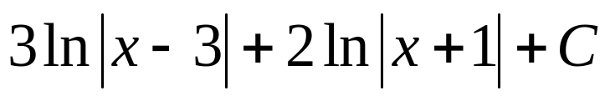
1
This technique is called
Partial Fractions
Solve two equations with two unknowns.

Slide 5

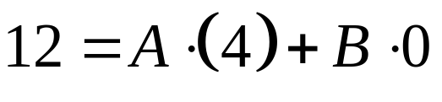
1
The short-cut for this type of problem is called the Heaviside Method, after English engineer Oliver Heaviside.
Multiply by the common denominator.
Let x = - 1
Let x = 3

Slide 6
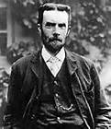
1
The short-cut for this type of problem is called the Heaviside Method, after English engineer Oliver Heaviside.

Slide 7
Good News!
The AP Exam only requires non-repeating linear factors!
The more complicated methods of partial fractions are good to know, and you might see them in college, but they will not be on the AP exam or on my exam.

Slide 8
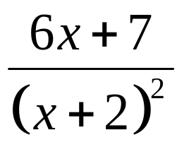
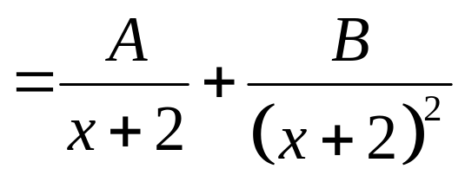
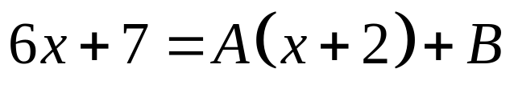





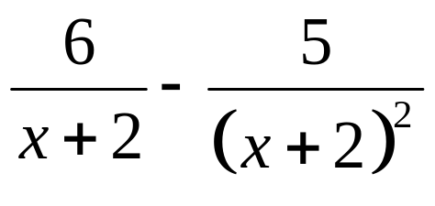


2
Repeated roots: we must use two terms for partial fractions.

Slide 9
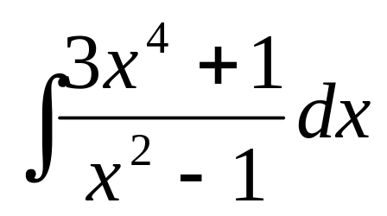
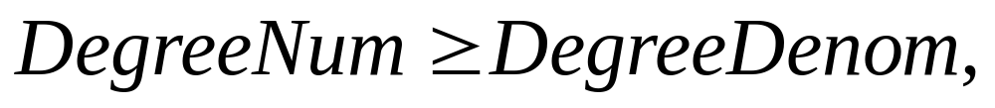
4
If the degree of the numerator is greater than or equal to the degree of the denominator, use long division first.
If
Then, Divide First

Slide 10
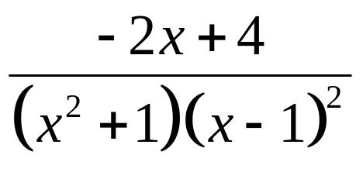
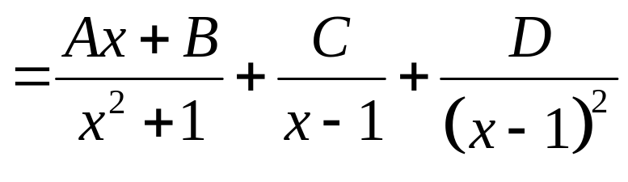
A challenging example:
first degree numerator
irreducible
quadratic
factor
repeated root

Slide 11




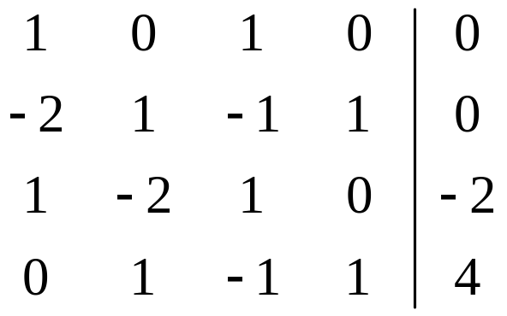
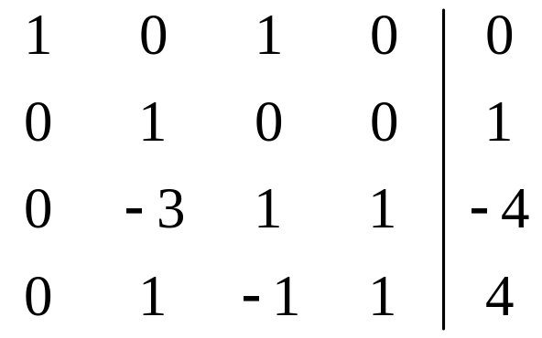




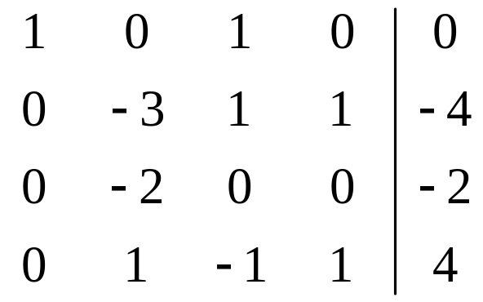
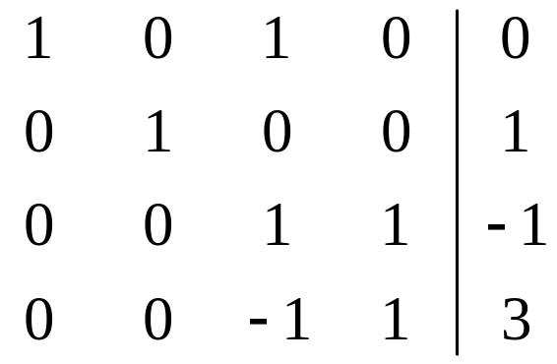



Slide 12
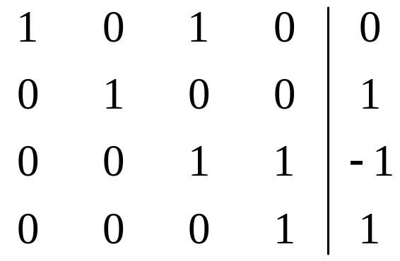

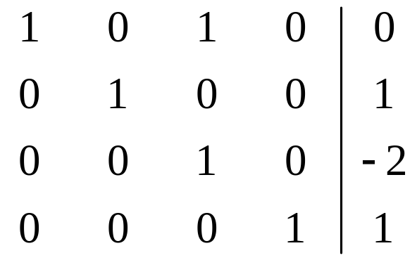

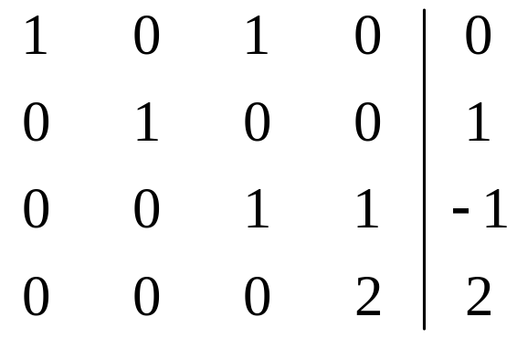
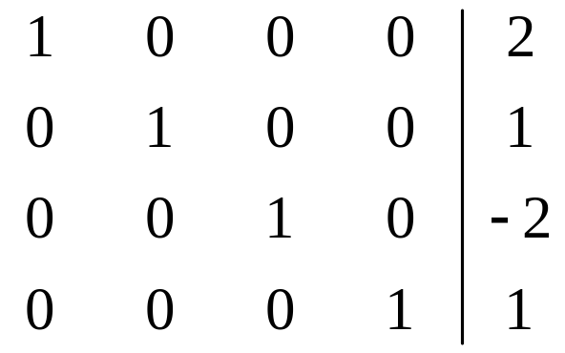


Slide 13
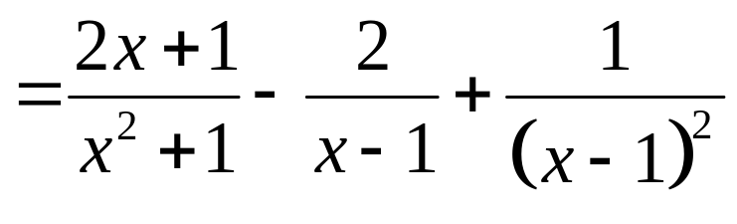
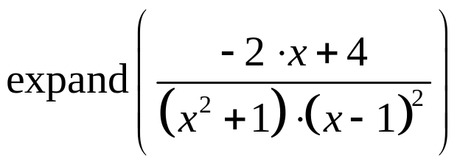
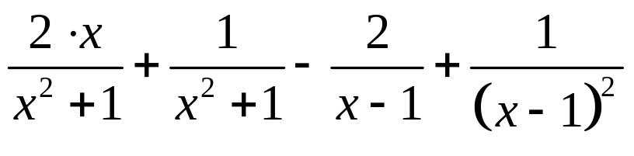
We can do this problem on the TI-89:
expand ((-2x+4)/((x^2+1)*(x-1)^2))
F2
3
Of course with the TI-89, we could just integrate and wouldn’t need partial fractions!
π

